Slide 1
Introduction to Python internals

Slide 2
What is a programming language
A set of instructions that enable a developer build software programs.
Compiled languages and interpreted languages.
Compiled languages translate high level programs to machine code
Interpreted languages execute high level programs in a virtual machine

Slide 3
Interpreted languages
PHP
Javascript
Lua
Ruby
Python
Java
Kotlin

Slide 4
Python
Interpreted language
General purpose.
Object oriented
Used in web, Ai, automation, games, graphics etc.

Slide 5
Internals
Object Oriented
Dynamically typed
Stack machine

Slide 6
Stack Machine
a = 1
b = 2
c = a + b

Slide 7
Stack machine
const a (1);
const b (2);
push a;
push b;
add;
pop top;
pop top;
top1 + top2
push result;
store result (c)

Slide 8
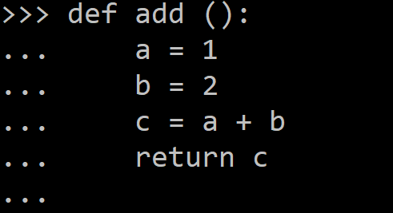
Stack machine

Slide 9
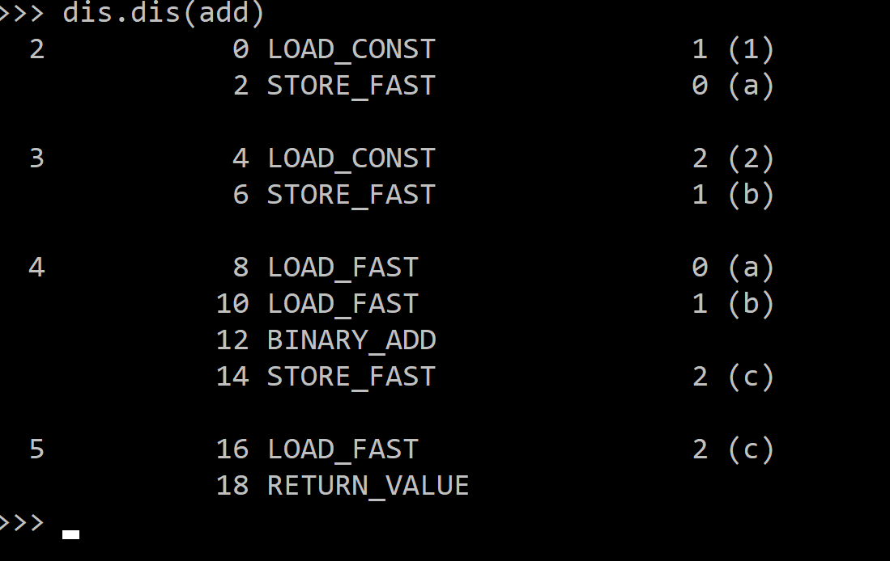
Stack machine

